Slide 1
OOPs

Slide 2
Agenda
• Access modifiers, encapsulation, immutability
• SOLID principles
• Static members & utility classes
• Inheritance vs composition
• Packages & modular structuring
• Lambda expressions
• Method references
• Custom functional interfaces
• Effective final variables
• Lists, Sets, Maps — internal working
• HashMap vs TreeMap
• Fail-fast vs fail-safe iterators
• Immutable collections (Java 17)
• Comparable vs Comparator

Slide 3
Access Specifier

Slide 4
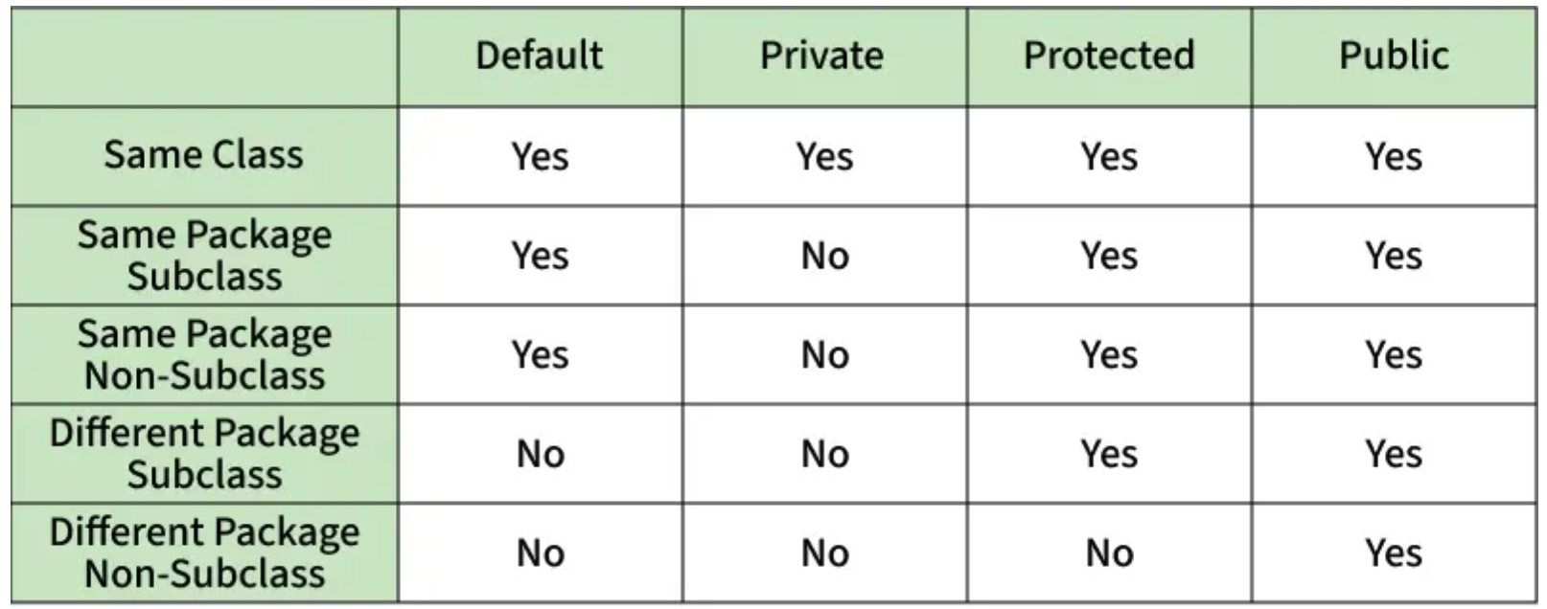
Access Control Summary Table
Private Access
Default Access
Private: Accessible only within the class.
Default (Package-Private): Accessible within the package.
Protected Access
Public Access & Best Practice
Protected: Accessible within the package and by subclasses.
Public: Accessible from anywhere. Use the most restrictive access specifier that allows the necessary functionality to be implemented. This minimizes dependencies and promotes better encapsulation.

Slide 5
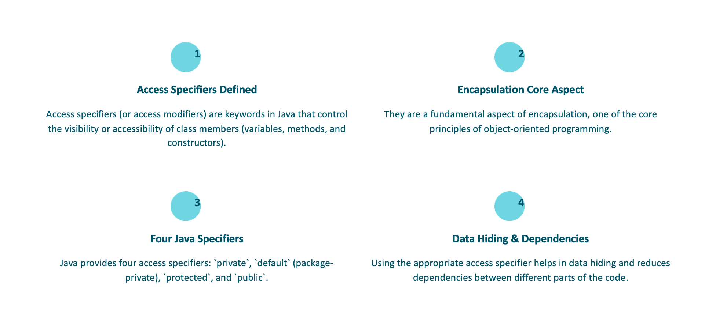
Access Specifier

Slide 6
Inheritance Vs Composition

Slide 7
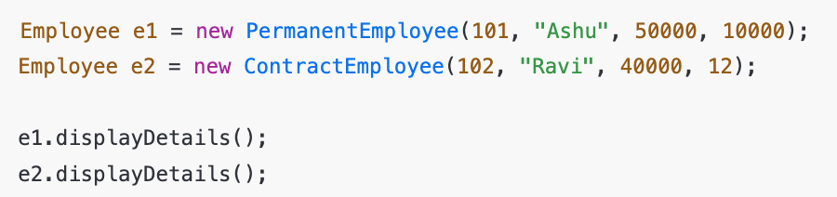
Inheritance
“Is a PermanentEmployee an Employee?”
- IS-A relationship
- Method overriding
- Polymorphism
- Code reuse via extends

Slide 8
Introduce a Problem
Intentionally break the design.
- “Now the company wants:
Salary calculation logic
Bonus calculation
Contract renewal logic
Tax calculation
Attendance-based pay”
“Should ALL employees have bonus?” “Should ALL employees have contract duration?”

Slide 9
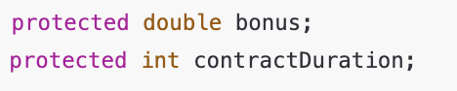
Show Inheritance Limitation
Add this to Employee
“Does a ContractEmployee have bonus?” “Does a PermanentEmployee have contract duration?”
? Bloated parent class
? Violates SRP
? Unnecessary data in child objects

Slide 10
Introduce Composition Conceptually (No Code Yet)
Question
“Instead of saying Employee IS-A Bonus, can we say Employee HAS-A BonusPolicy?”

Slide 11
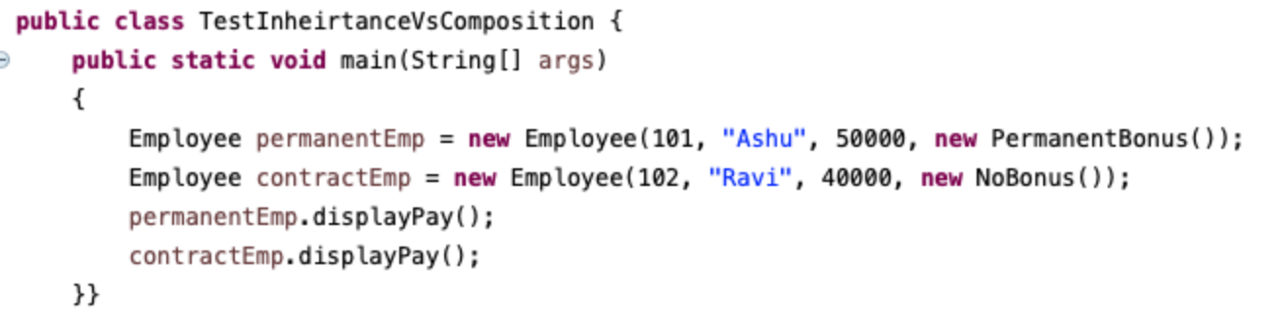
Refactor to Composition
Question
“Instead of saying Employee IS-A Bonus, can we say Employee HAS-A BonusPolicy?”

Slide 12
Aspect | Inheritance | Composition
Relationship | IS-A | HAS-A
Flexibility | Low | High
Runtime behavior change | ❌ | ✅
SRP | Often violated | Maintained
Tight coupling | Yes | No
Preferred in design | ❌ | ✅
“Use inheritance to represent what an object is. Use composition to represent what an object does.”

Slide 13
Inheritance (extends) | Composition (has-a)
ContractEmployee IS-A Employee | Employee HAS-A Contract
Static relationship | Dynamic relationship
Many subclasses | Fewer classes
Rigid | Flexible
Hard to change | Easy to extend

Slide 14
Utility Classes

Slide 15
What Is a Utility Class?
A utility class is a class that:
Contains only static methods
Has no object state
Is not meant to be instantiated
Provides common reusable functionality
Example :
Math
Collections
Arrays
Objects

Slide 16
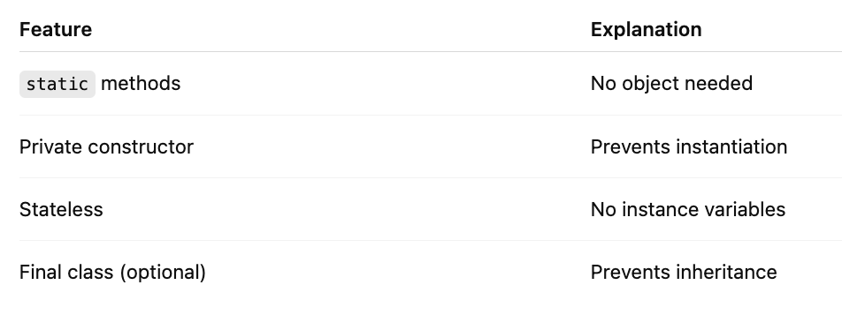
Characteristics of Utility Classes

Slide 17
Utility classes
Maths:
Math.max(10, 20);
Math.sqrt(25);
Objects:
Objects.requireNonNull(obj);
Objects.equals(a, b);
Collections:
Collections.sort(list);
Collections.unmodifiableList(list);
Arrays:
Arrays.sort(arr);
Arrays.stream(arr);

Slide 18
“Utility classes are best for stateless, reusable behavior and should never contain business or variable logic.”

Slide 19
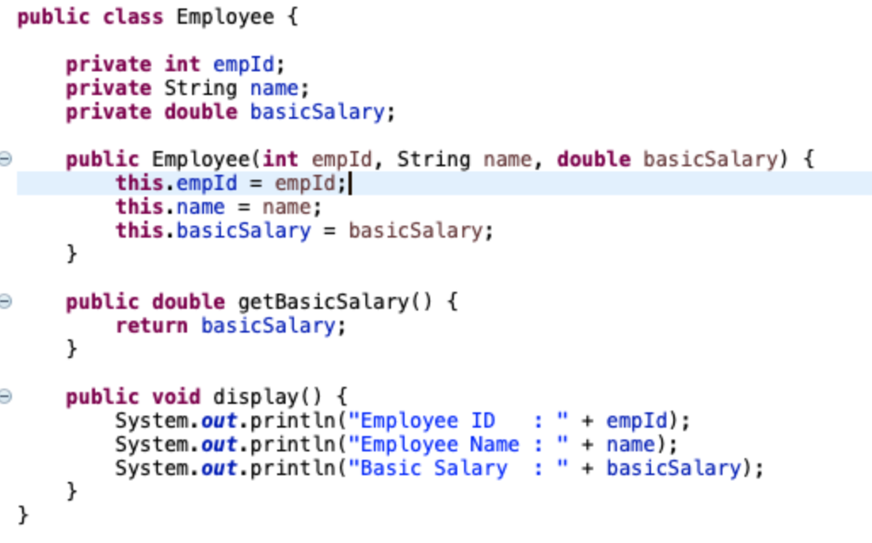
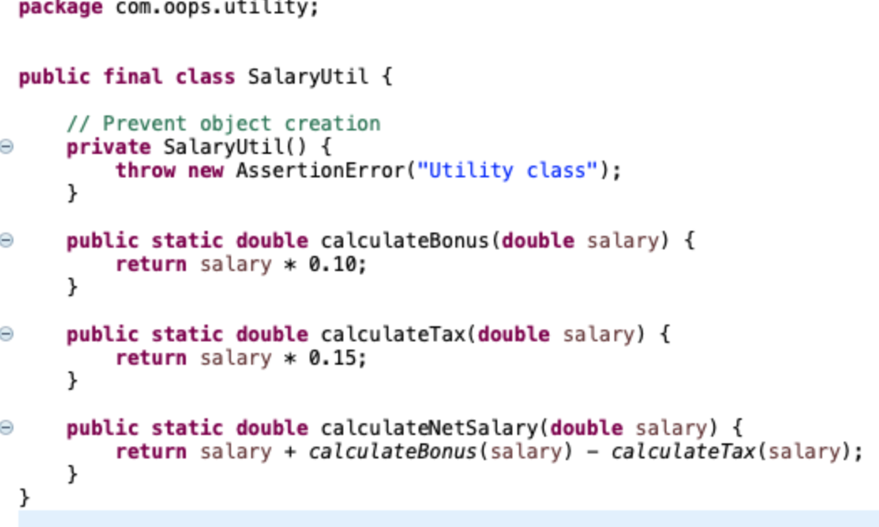
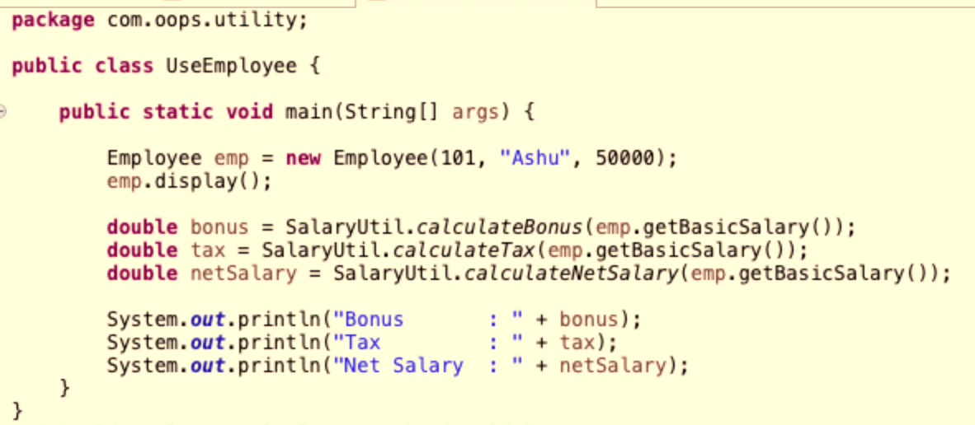
1. Tax & bonus rules are generic
2. Used by many entities
3. Belongs in a utility class
“Employee represents who the employee is; SalaryUtil represents what we do with salary.”

Slide 20
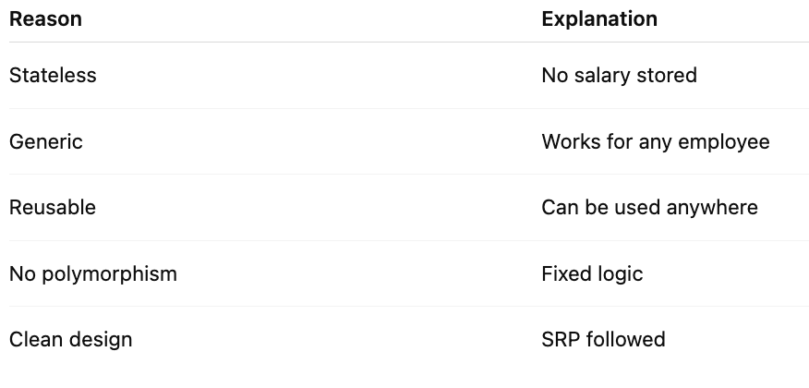
Why good to use Utility class?

Slide 21
Static Members

Slide 22
Static Members & utility classes

Slide 23
What is static members?
In Java, static members belong to the class, not to objects.
👉 Only one copy exists, shared by all objects.
Static Members Include:
Static variables
Static methods
Static blocks
Static nested classes

Slide 24
Static Variables (Class Variables)
A static variable is shared among all objects of a class.
Memory allocated once
Accessed using ClassName.variable
Good for constants & shared data

Slide 25
Static Methods
A static method can be called without creating an object.
Cannot access non-static variables directly
Cannot use this or super
Can access only static members

Slide 26
Static Block
A static block is executed once when the class is loaded.
Use Cases
Load drivers
Initialize static data
One-time setup
Static Inner Class | Non-Static Inner Class
No outer object needed | Requires outer object
Can access static members only | Can access all members

Slide 27
Solid Principle

Slide 29

SOLID Principle
S - SRP- Single Responsibility Principle
O - OP – Open Closed Principal
L - LSP – Liskov Substitution Principle
I - ISP – Interface Segregation Principle
D - DIP – Dependency Inversion Principle

Slide 30
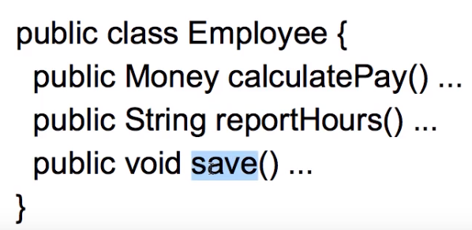
Single Responsibility Principle
A class should have one and only one reason to change.
Increase the possibility of reusability

Slide 31
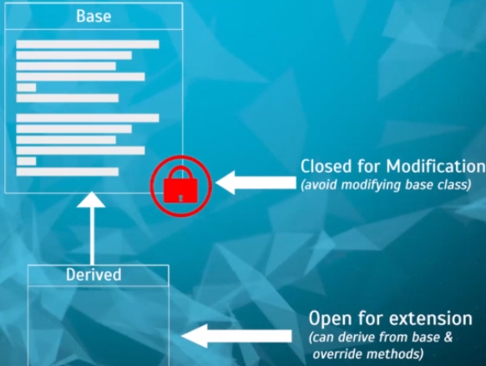
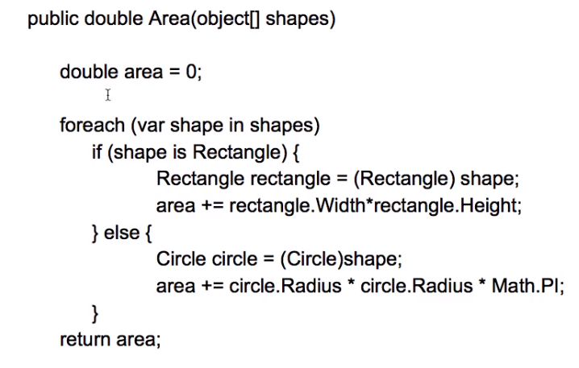
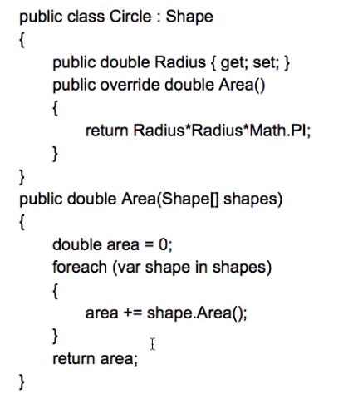
Open Closed Principle
Software entities should be open for extension but closed for modification.
Problem
Solution
To add a new shape, will lead to modification
Now, area is calculation is based on shape

Slide 32
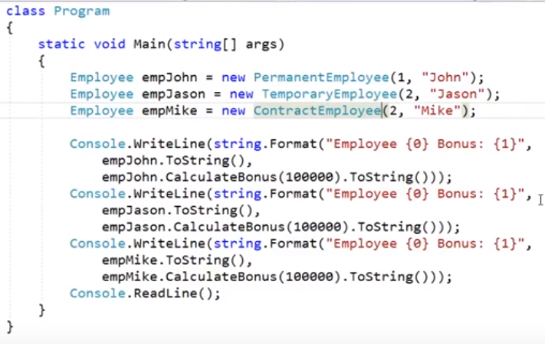
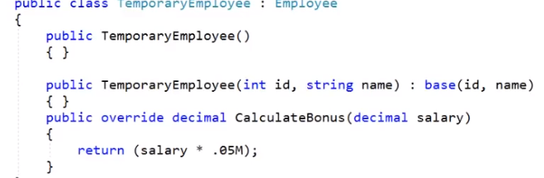
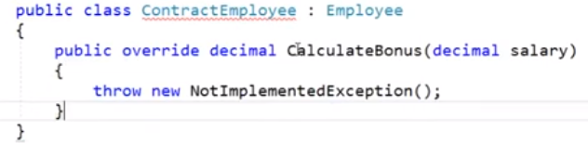
Liskov Substitution Principle
Substitute must be substitutable for their base types.
We should be to substitute the base class objects with child class objects
-> Barabara Liskov
Extension of Open closed principle.
No, new exception should be thrown by sub type

Slide 33
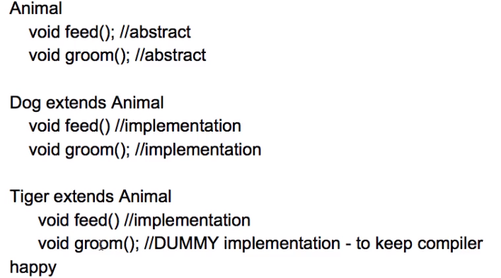
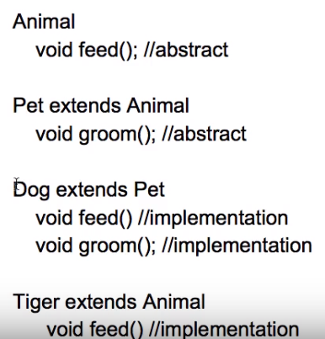
Interface Segregation Principle (ISP)
The dependency of one class to another one should depend on smallest possible interface.
Client should not force to implement interfaces they don’t use.
Problem
Solution

Slide 34
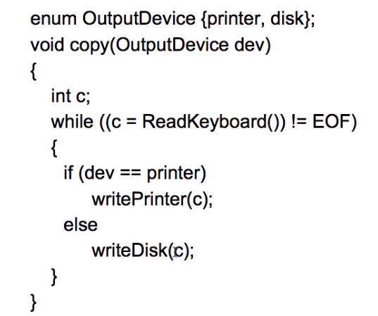
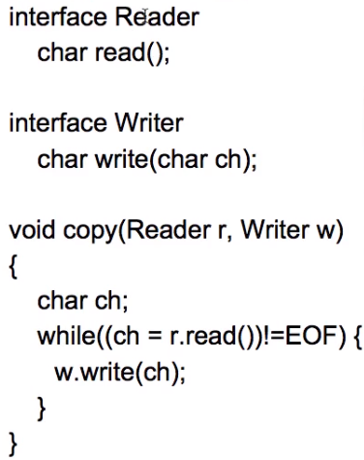
Dependency Inversion Principle
Dependent on interface not on concrete interfaces.
Introduced by “Robert C Martin”
Problem
Solution
On adding new IO device copy () must be updated.
Now no need to modify the copy()

Slide 35
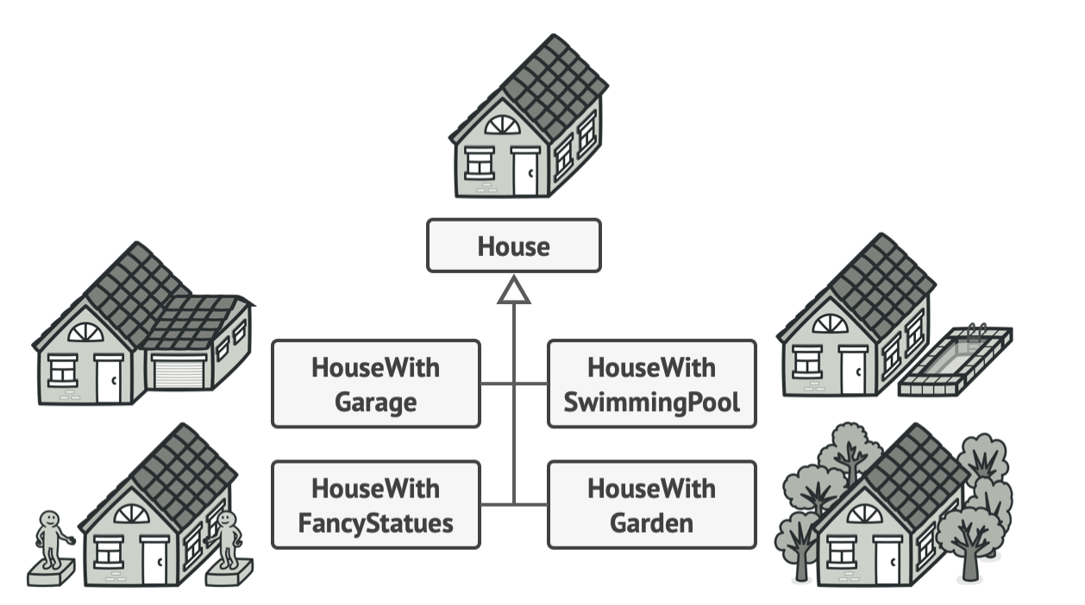
Common Design Pattern
Singleton Design Pattern.
Builder Desing Pattern
Allows step-by-step construction of an object
Improves readability and maintainability
Factory Method Pattern
Focuses on which class to instantiate, not optional fields
Adapter
Used to make incompatible interfaces work together

Slide 36
Package Structuring and Modularization

Slide 37
What is Package Structuring?
A package is a namespace that groups related classes and interfaces.
Good package structure:
Improves readability
Reduces coupling
Improves maintainability
Supports clean architecture

Slide 38
Why Package Structure Matters?
Poor structure leads to:
God classes
Circular dependencies
Hard-to-test code
Difficult onboarding
Good structure provides:
Clear responsibilities
Scalable codebase
Easy refactoring
Clean separation of concerns

Slide 39
Layered Packaging
com.cg.app
├── controller
├── service
├── repository
├── model
└── util
Pros:
✔ Easy to understand ✔ Popular in tutorials
Cons:
✔ Business logic spread across packages
✔ Feature understanding is difficult

Slide 40
Package Structuring Rules (Best Practices)
High Cohesion
Low Coupling
No Cyclic Dependencies

Slide 41
Module : Problem WITHOUT Modules
We are building an Employee Management System with two teams:
HR Team → Employee APIs
Payroll Team → Salary processing

Slide 42
Module Structuring (Java 9+ / Large Applications)
What is a Module?
A module is a group of packages with:
Explicit dependencies
Strong encapsulation
Introduced in Java 9 (JPMS)
Before (Classpath) | After (Modules)
Everything visible | Only exported packages
Runtime errors | Compile-time safety
Weak security | Strong encapsulation
Hidden dependencies | Explicit requires
Large JVM | Custom runtime possible

Slide 43
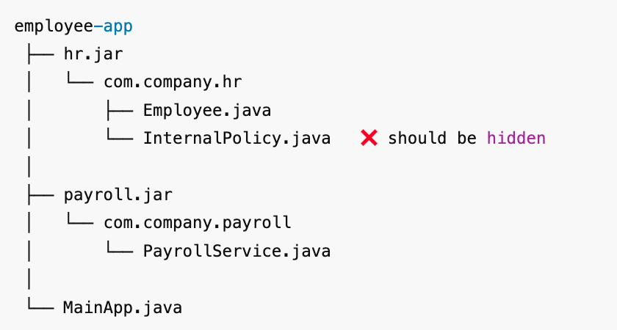
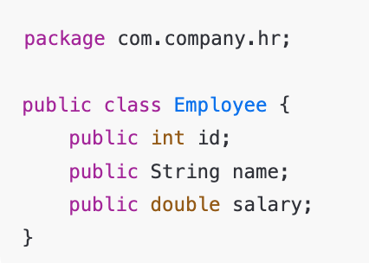
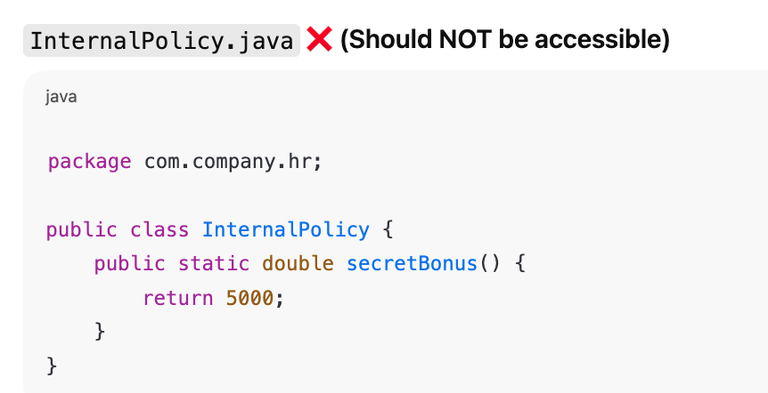
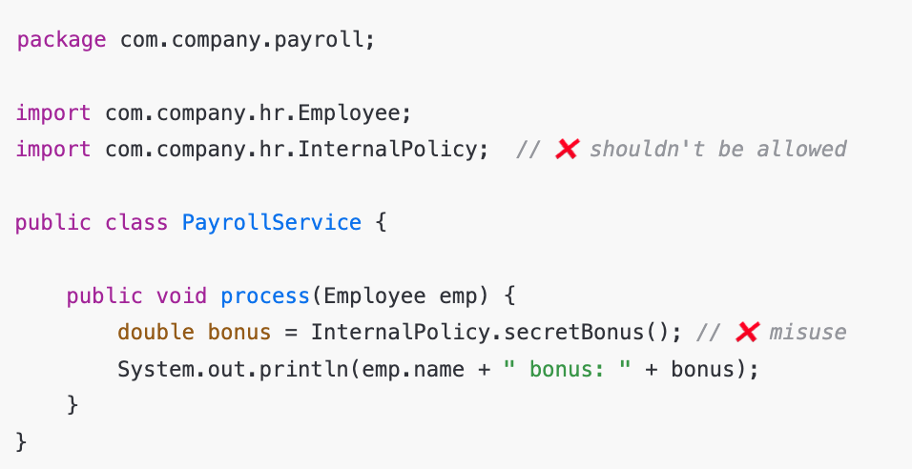
Without Module
? “How do we stop Payroll from accessing InternalPolicy?”

Slide 44
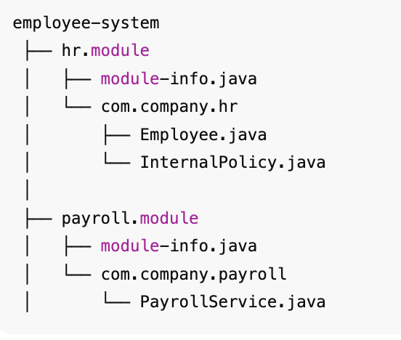
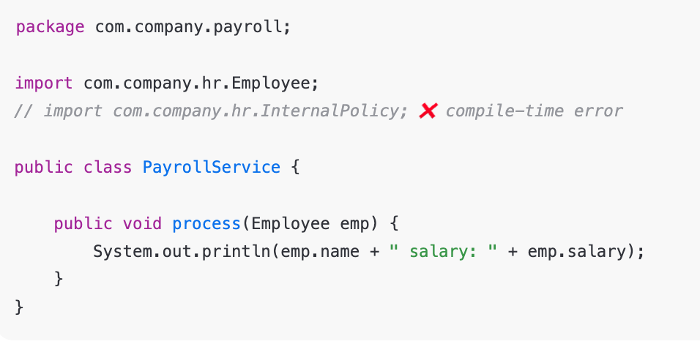
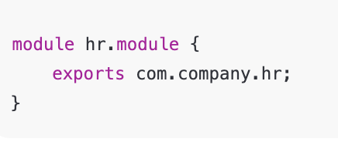
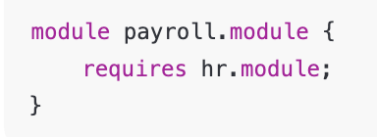
With Module in Java 9+
HR Module
📌 Only Employee is visible 📌 InternalPolicy is hidden automatically
Payroll Module

Slide 45
Package vs Module
Aspect | Package | Module
Level | Logical grouping | Physical + logical
Introduced | Java 1.0 | Java 9
Visibility | Public / default | Strong encapsulation
Dependency Control | Weak | Strong
Used In | Small to large apps | Large / enterprise apps

Slide 46
Functional Interface
A functional interface is an interface that contains exactly one abstract method.
This single abstract method makes the interface suitable for use with lambda expressions and method references.
Functional interfaces can have multiple default or static methods, but only one abstract method.
@FunctionalInterface annotation is used to explicitly declare an interface as a functional interface.

Slide 47
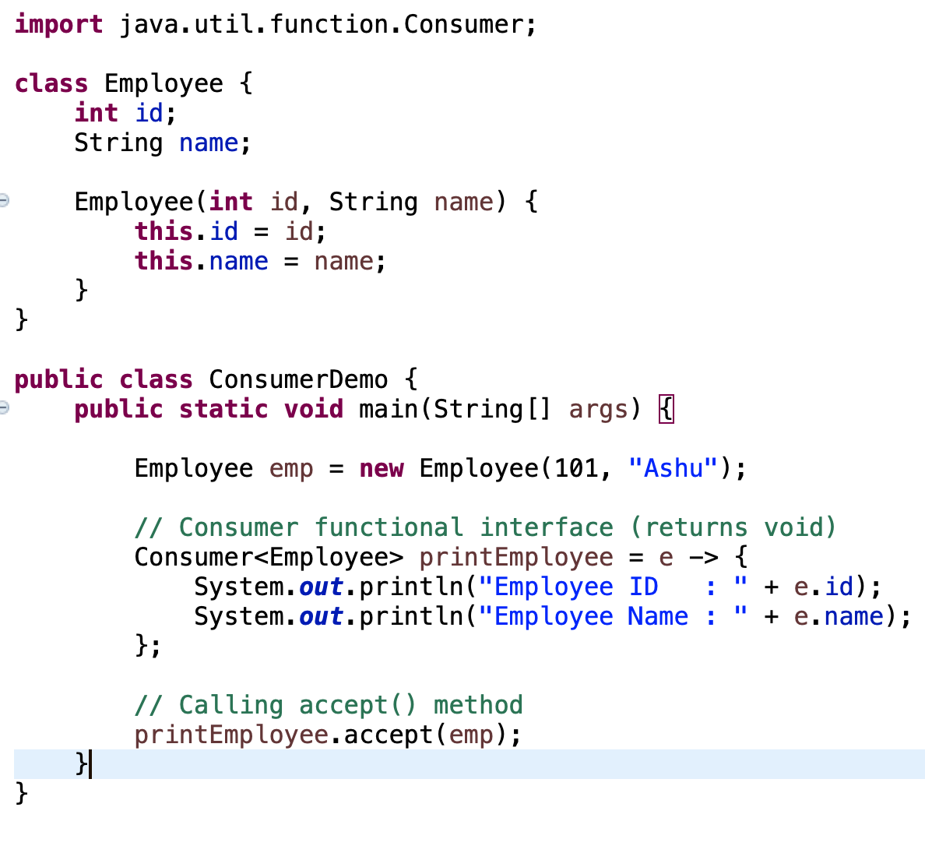
Consumer
Consumer is a functional interface that performs an action and returns no value.

Slide 48
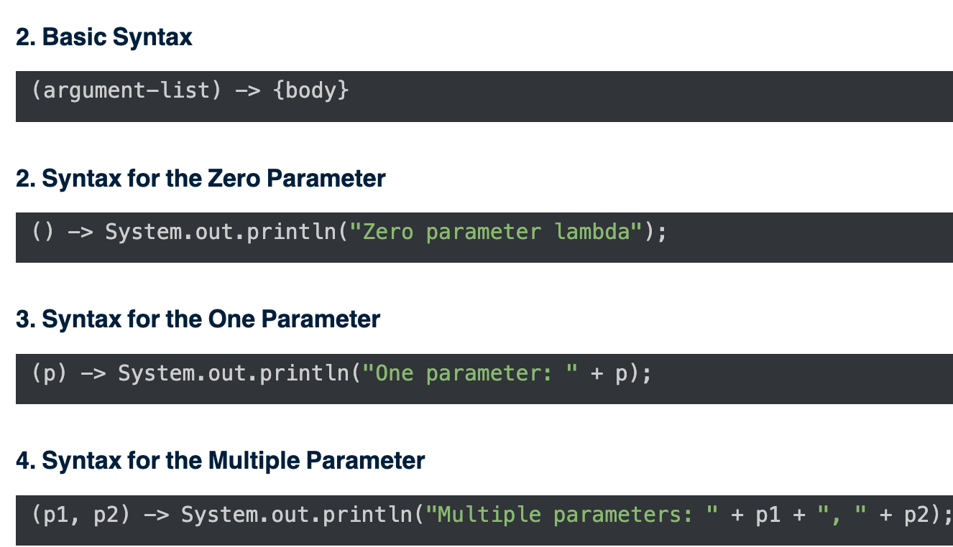
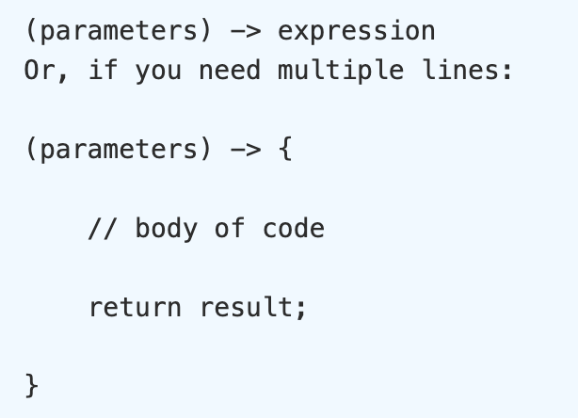
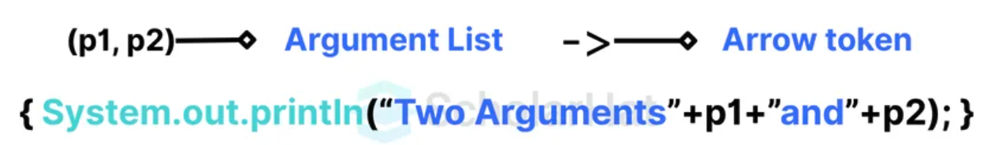
Lambda expressions
Lambda expressions provide a concise way to implement functional interfaces by replacing anonymous classes that contain only one abstract method.

Slide 49
Lambda Function
Cleaner Code: Eliminates the need for unnecessary class definitions.
Improved Readability: Shorter syntax makes logic easier to follow.
Functional Programming Support: Brings Java closer to modern paradigms like map, filter, and reduce.
Better Parallelism: Works seamlessly with streams for parallel processing.
Flexibility: Behavior can be treated as a value and passed around.

Slide 50
Lambda Function
Debugging Challenges: Stack traces may be less informative compared to named classes.
Overuse Risks: Using lambdas in deeply nested logic can hurt readability.
Limited Reusability: A lambda is tied to a single-use context unless refactored into a method reference.
Learning Curve: Developers new to functional programming might find them confusing at first.

Slide 51
Method references
A method reference works in case of functional interfaces. Wherever, we are calling a method of a functional interface with a lambda expression, we can use a method reference.
Method references help to point to methods by their names even without specifying the arguments. Arguments are passed by the lambda expression.
A method reference is described using the "::" symbol.

Slide 52
Method Reference – Why?
Using the method reference in our code makes it easier to understand, and it increases the readability.
The Method references support the functional programming style, which makes it easier to work with streams and collections.
The chances of logical and typo errors are lower, and as no boilerplate is required, reusability increases as we use the existing methods.

Slide 53
Method Reference
Static Methods
Instance Method of a Particular Object
Constructors using New operator (TreeSet::new)

Slide 54
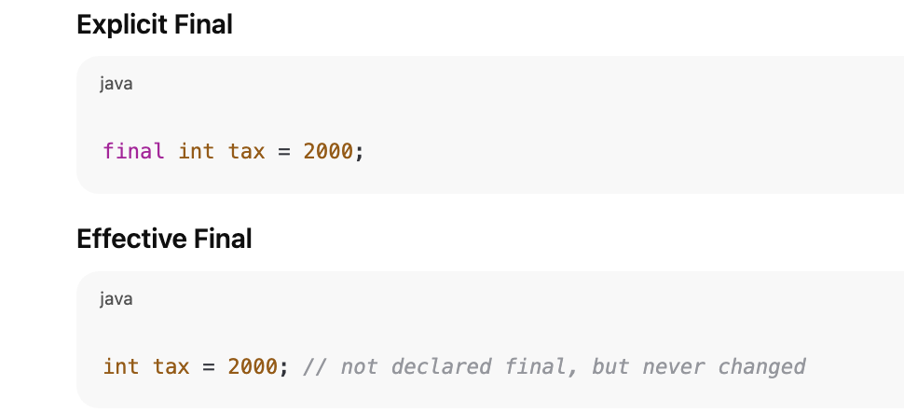
Effective final variables
Effective final variables are variables whose value is assigned once and never changed, even though they are not explicitly declared as final.
Java treats them as if they were final, especially when used in:
Lambda expressions
Anonymous classes
Local inner classes
This avoids unexpected changes and makes code thread-safe and predictable.

Slide 55

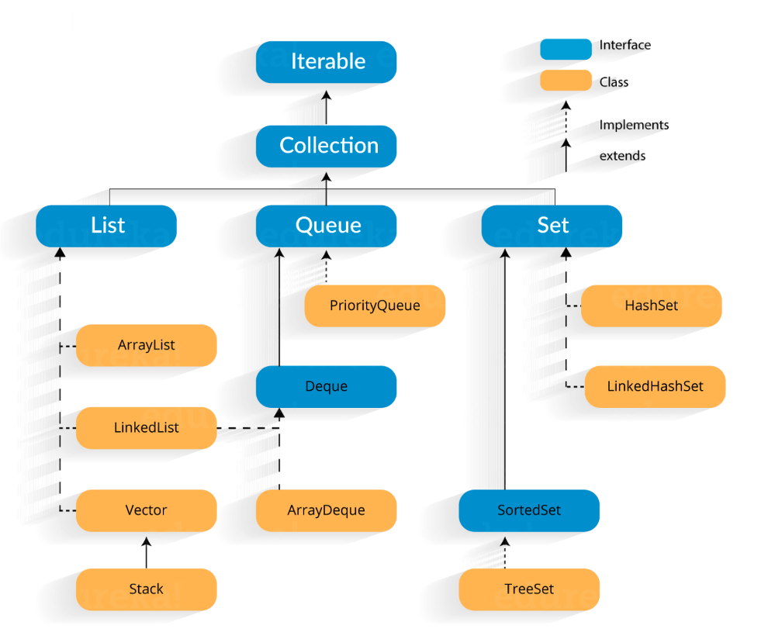
Collections
A Java collection framework provides an architecture to store and manipulate a group of objects. A Java collection framework includes the following:
Interfaces
Classes
Algorithm

Slide 56
Why Collection?
Reducing the effort required to write the code by providing useful data structures and algorithms
Java collections provide high-performance and high-quality data structures and algorithms thereby increasing the speed and quality
Unrelated APIs can pass collection interfaces back and forth
Decreases extra effort required to learn, use, and design new API’s
Supports reusability of standard data structures and algorithms

Slide 57
Collection | Duplicates | Order | Internal Structure
ArrayList | ✅ | ✅ | Dynamic Array
HashSet | ❌ | ❌ | HashMap
LinkedHashSet | ❌ | ✅ | HashMap + DLL
TreeSet | ❌ | Sorted | Red-Black Tree

Slide 58
Exception
Collectors.toMap() - IllegalStateException

Slide 59
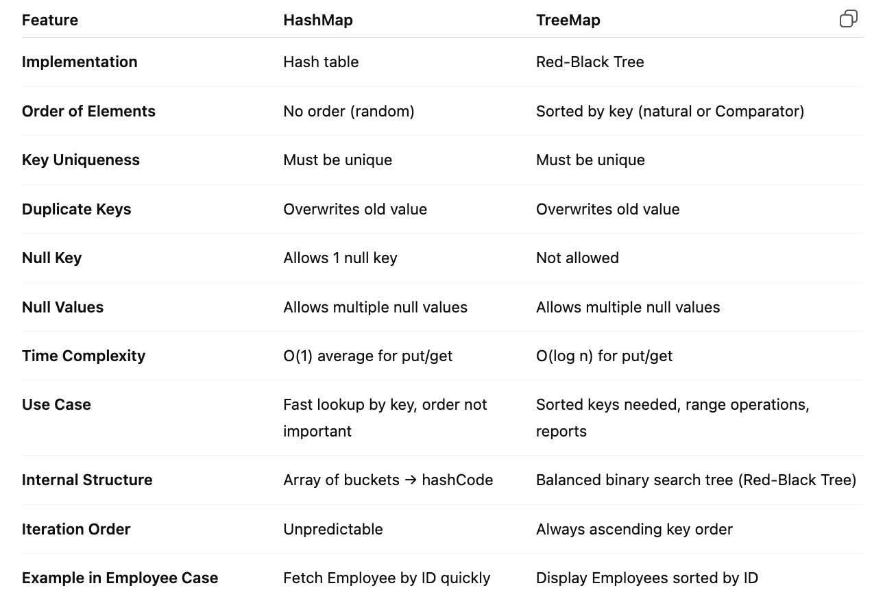
HashMap vs TreeMap

Slide 60
Fail-Fast Iterator
An iterator that immediately throws ConcurrentModificationException if the underlying collection is modified structurally (add/remove elements) after the iterator is created.
Works on most core Java collections like ArrayList, HashMap, HashSet.
Key:
Does not allow concurrent modification.
Faster than fail-safe because it works directly on the original collection.

Slide 61
Fail-Safe Iterator
An iterator that does NOT throw ConcurrentModificationException if the collection is modified while iterating.
Works on concurrent collections like ConcurrentHashMap, CopyOnWriteArrayList.
It works on a clone or copy of the collection internally → safe from modifications.
Key:
Slower than fail-fast because of copying.
Allows concurrent read/write operations.

Slide 62
Feature / Concept | Details | Example with Employee
List | Ordered, allows duplicates, indexed | ArrayList<Employee> list = new ArrayList<>();
Set | No duplicates, unordered (HashSet) or sorted (TreeSet) | Set<Employee> set = new HashSet<>();
HashSet | Uses hash table, no order, O(1) lookup | HashSet<Employee> hs = new HashSet<>();
TreeSet | Uses Red-Black Tree, sorted by Comparable or Comparator, O(log n) | TreeSet<Employee> ts = new TreeSet<>(new SalaryComparator());
Map | Key-value pair, keys unique | Map<Integer, Employee> map = new HashMap<>();
HashMap | Unordered, O(1) avg put/get, allows 1 null key | Map<Integer, Employee> hm = new HashMap<>();
TreeMap | Sorted by key (natural/comparator), O(log n) put/get | TreeMap<Integer, Employee> tm = new TreeMap<>();
Fetch by key | Direct lookup using key | Employee e = map.get(102);
Sorting by key | TreeMap automatically sorts keys | TreeMap<Integer, Employee> → sorted by ID
Sorting by value | Convert entries to list + Comparator | List<Map.Entry<Integer, Employee>> list = new ArrayList<>(map.entrySet());
Comparable | Natural ordering inside class (compareTo) | Employee implements Comparable<Employee> → compare by salary
Comparator | External ordering, reusable | SalaryComparator, NameComparator
Fail-Fast Iterator | Throws ConcurrentModificationException on modification | ArrayList<Employee> iterator
Fail-Safe Iterator | Does not throw exception, works on copy | CopyOnWriteArrayList<Employee> iterator
Internal Structure - HashMap | Array of buckets + linked list/tree (hashCode) | Fast lookup O(1) avg
Internal Structure - TreeMap | Red-Black Tree | Sorted by key, O(log n) lookup
Duplicates | List → allowed, Set → not allowed, Map → key must be unique | HashSet<Employee> ignores duplicates based on equals()
Iteration Order | List → insertion, HashSet/HashMap → unordered, TreeSet/TreeMap → sorted | for(Employee e : ts) → sorted automatically
Use Case - Employee Example | Lookup by ID → HashMap, Display sorted by salary → TreeSet, Sorted by name → TreeSet with NameComparator | Quick access, reporting, ranking

Slide 63
Immutable Collection- Java 17
An immutable collection is a collection whose elements cannot be added, removed, or modified after creation.
Java 17 provides factory methods in List, Set, and Map to easily create immutable collections.

Slide 64
Why Immutable Collection?
Advantage | Explanation
Thread-safe | No need for synchronization when reading from multiple threads
Safe from modification | Prevent accidental changes to important data
Predictable behavior | No surprises when passing to methods or sharing across classes
Memory & performance optimization | Internal optimizations for small, fixed-size collections

Slide 65
Factory Method
Collection Type | Method | Example
List | List.of() | List<Employee> list = List.of(emp1, emp2);
Set | Set.of() | Set<Employee> set = Set.of(emp1, emp2);
Map | Map.of() | Map<Integer, Employee> map = Map.of(101, emp1, 102, emp2);

Slide 66
SOLID Principle

Slide 67
SOLID Principle
S - SRP- Single Responsibility Principle
O - OP – Open Closed Principal
L - LSP – Liskov Substitution Principle
I - ISP – Interface Segregation Principle
D - DIP – Dependency Inversion Principle

Slide 68
Single Responsibility Principle
A class should have one and only one reason to change.
Increase the possibility of reusability

Slide 69
Open Closed Principle
Software entities should be open for extension but closed for modification.
Problem
Solution
To add a new shape, will lead to modification
Now, area is calculation is based on shape

Slide 70
Liskov Substitution Principle
Substitute must be substitutable for their base types.
We should be to substitute the base class objects with child class objects
-> Barabara Liskov
Extension of Open closed principle.
No, new exception should be thrown by sub type

Slide 71
Interface Segregation Principle (ISP)
The dependency of one class to another one should depend on smallest possible interface.
Client should not force to implement interfaces they don’t use.
Problem
Solution

Slide 72
Dependency Inversion Principle
Dependent on interface not on concrete interfaces.
Introduced by “Robert C Martin”
Problem
Solution
On adding new IO device copy () must be updated.
Now no need to modify the copy()

